Slide 1
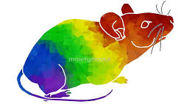

Ketamine in Rodent Models
Jess Hoynoski

Slide 2

Psychedelics (serotonergic hallucinogens)
Powerful psychoactive substances that alter perception, mood, and affect numerous cognitive processes
  Physiologically safe
  Non-addictive
  Not dependence inducing
  Nichols D. E. (2016). Psychedelics. Pharmacological reviews, 68(2), 264-355.

Slide 3
Types
Classic Hallucinogens
  LSD (d-lysergic acid diethylamide)
  Psilocybin (4-phosphoryloxy-N,N-dimethyltryptamine)
  Peyote (Mescaline)
  DMT (Dimethyltryptamine)
  Ayahuasca
Dissociative Drugs
  PCP (Phencyclidine)
  Ketamine
  DXM (Dextromethorphan)
  Salvia divinorum
  https://www.drugabuse.gov/publications/research-reports/hallucinogens-dissociative-drugs/what-are-dissociative-drugs

Slide 4
Effects
Increased energy and heart rate
Nausea
Hallucinations
Intensified feelings and sensory experiences
Mixed senses (ex. seeing sounds)
Altered sense of time
https://www.drugabuse.gov/publications/hallucinogens-dissociative-drugs/how-do-hallucinogens-lsd-psilocybin-peyote-dmt-ayahuasca-affect-brain-body

Slide 5
Animal Behaviors
Head-twitch
Drug discriminations
Locomotion/exploration
PPI disruption
Conflict anxiety tests
Impulsivity
Peak interval timing
Fear conditioning
Fear extinction
https://www.ncbi.nlm.nih.gov/pmc/articles/PMC3547517/

Slide 6

Lilius et al 2018

Slide 7
Reversal Effect of Morphine Anti-Nociceptive Tolerance

Slide 8
Reversal Effect of Oxycodone Anti-Nociceptive Tolerance

Slide 9
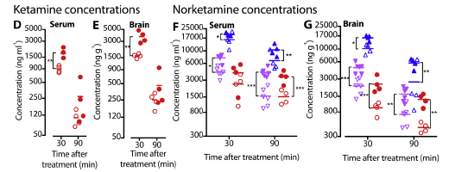
Serum and Whole Brain Concentrations after Morphine

Slide 10
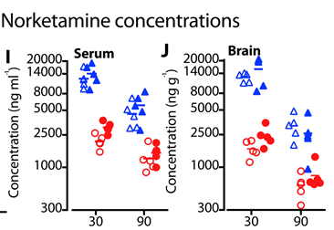
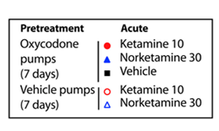
Serum and Whole Brain Concentrations after Oxycodone

Slide 11
Summary
Ketamine and norketamine (at a higher dose) effectively attenuated morphine tolerance
  Not so much with oxycodone
Inhibition of morphine metabolism by ketamine and norketamine
  3-5x increase in brain morphine concentrations

Slide 12
Ossato et al 2018

Slide 13
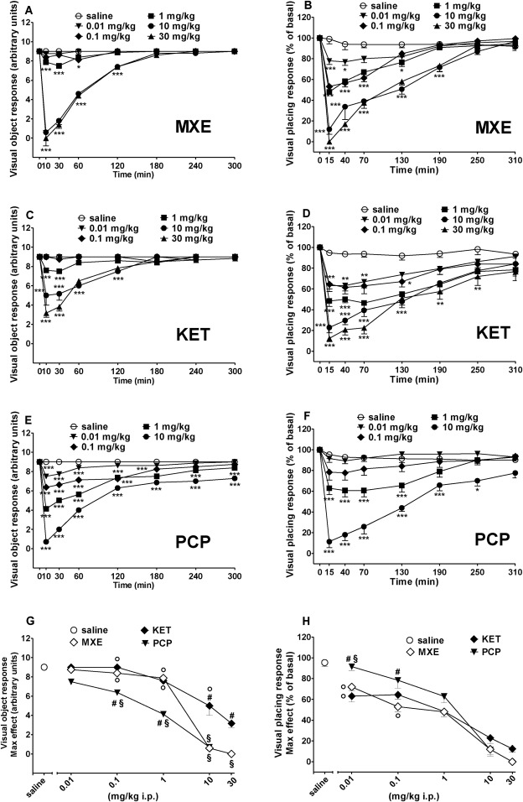
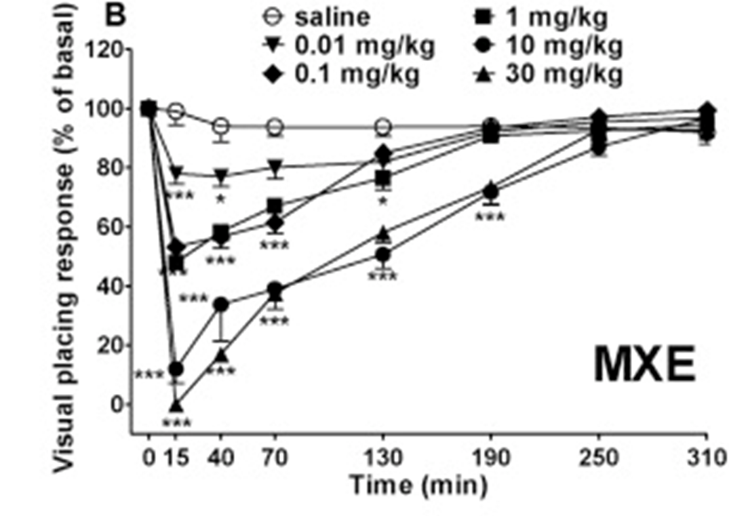
Visual Object vs Visual Placing

Slide 14
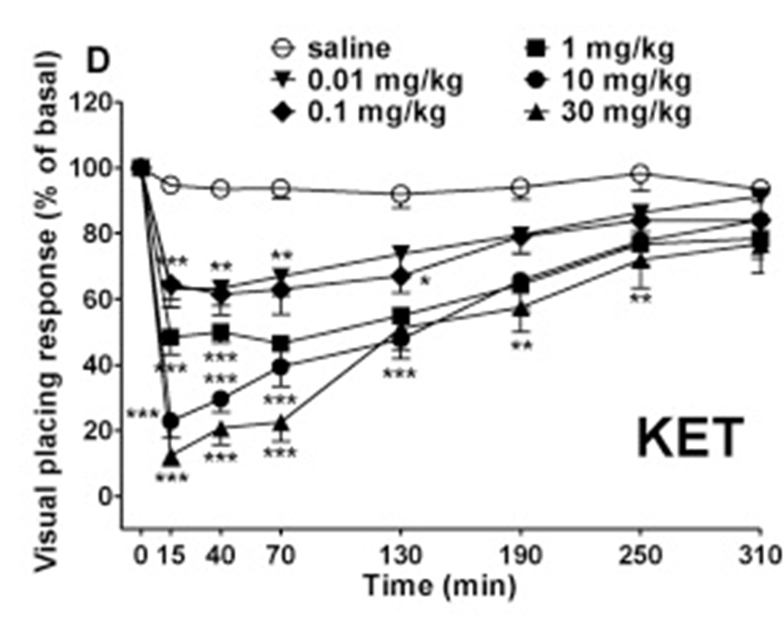
Visual Object vs Visual Placing

Slide 15
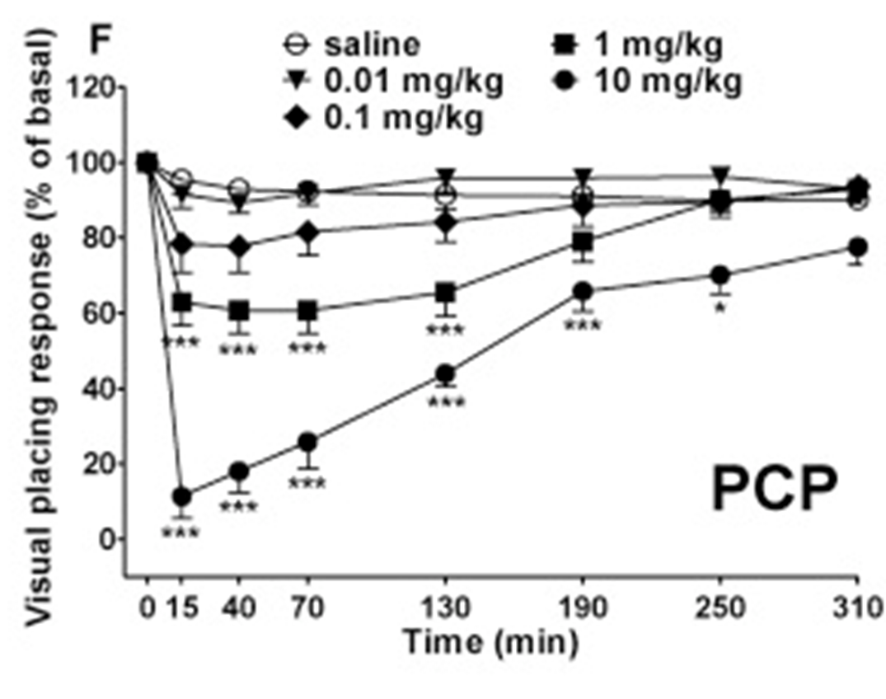
Visual Object vs Visual Placing

Slide 16
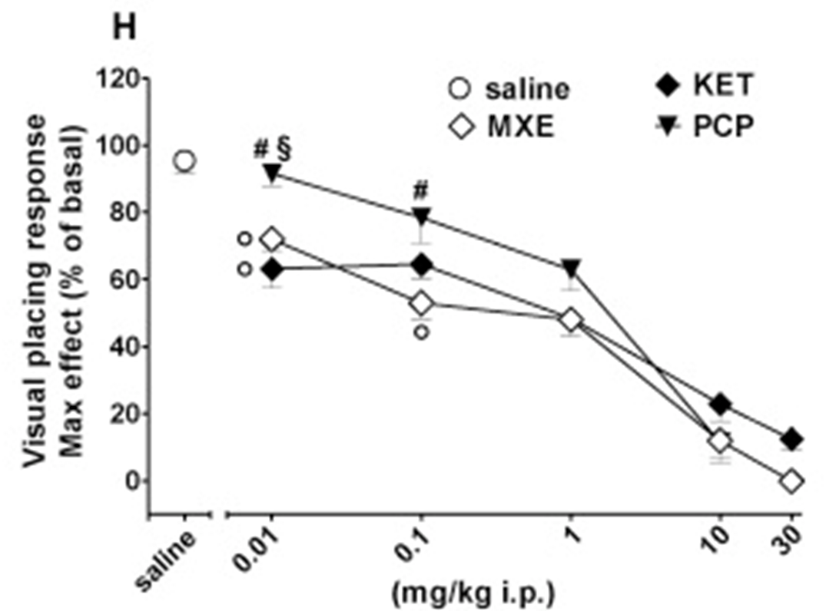
Overall Responses

Slide 17
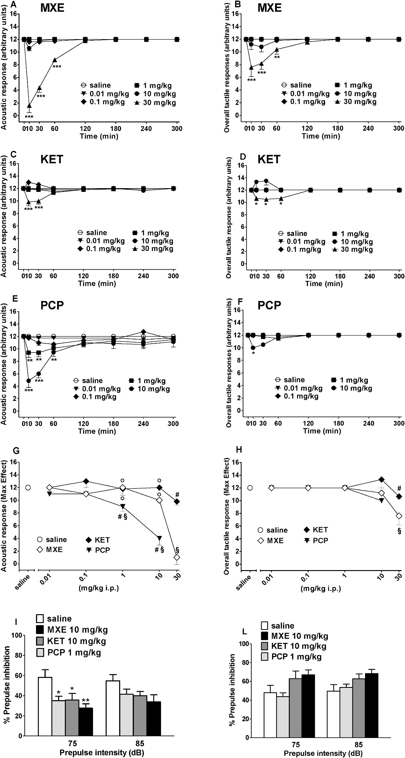
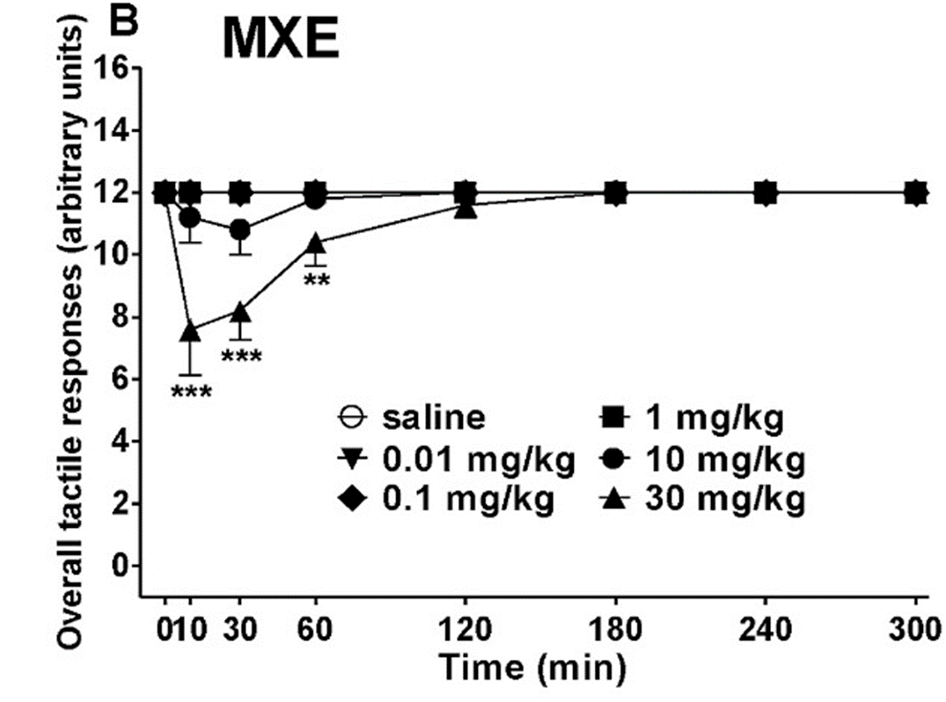
Acoustic vs Tactile

Slide 18
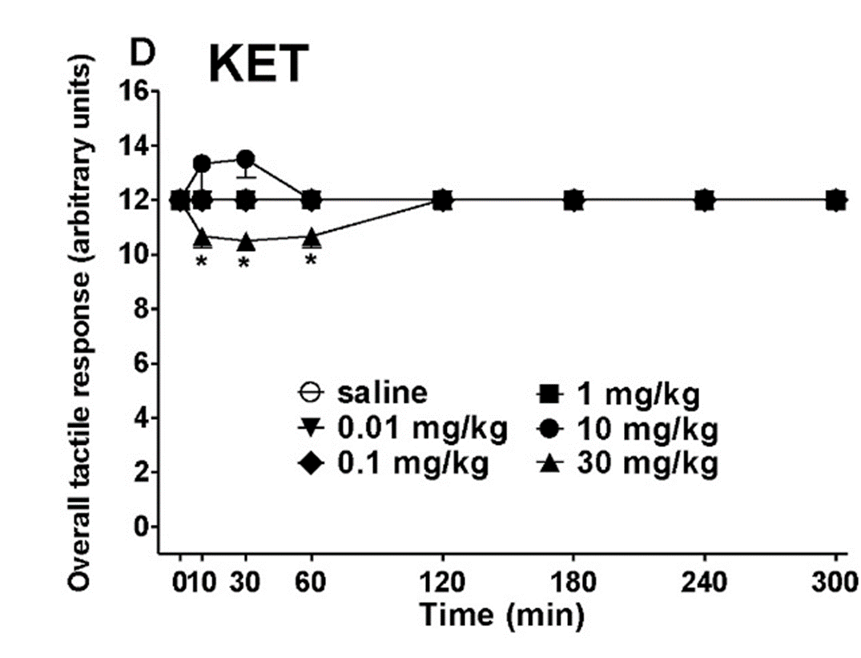
Acoustic vs Tactile

Slide 19
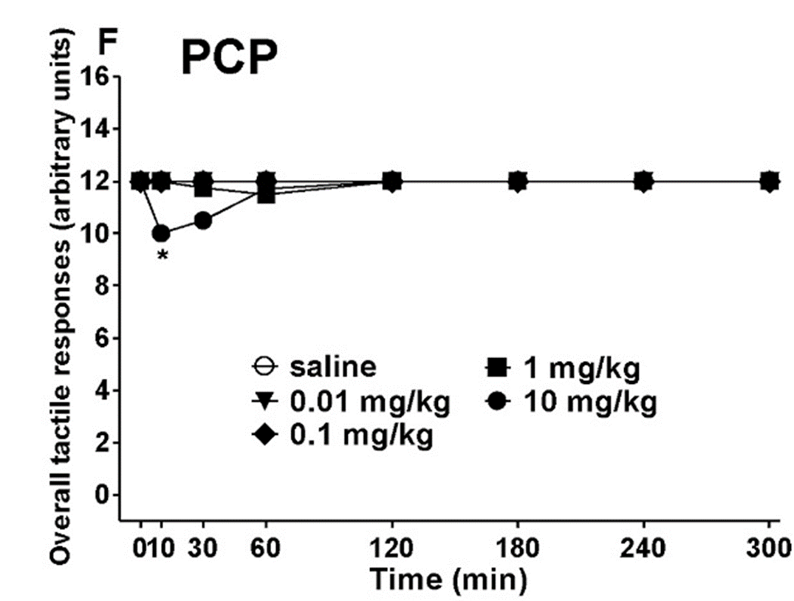
Acoustic vs Tactile

Slide 20
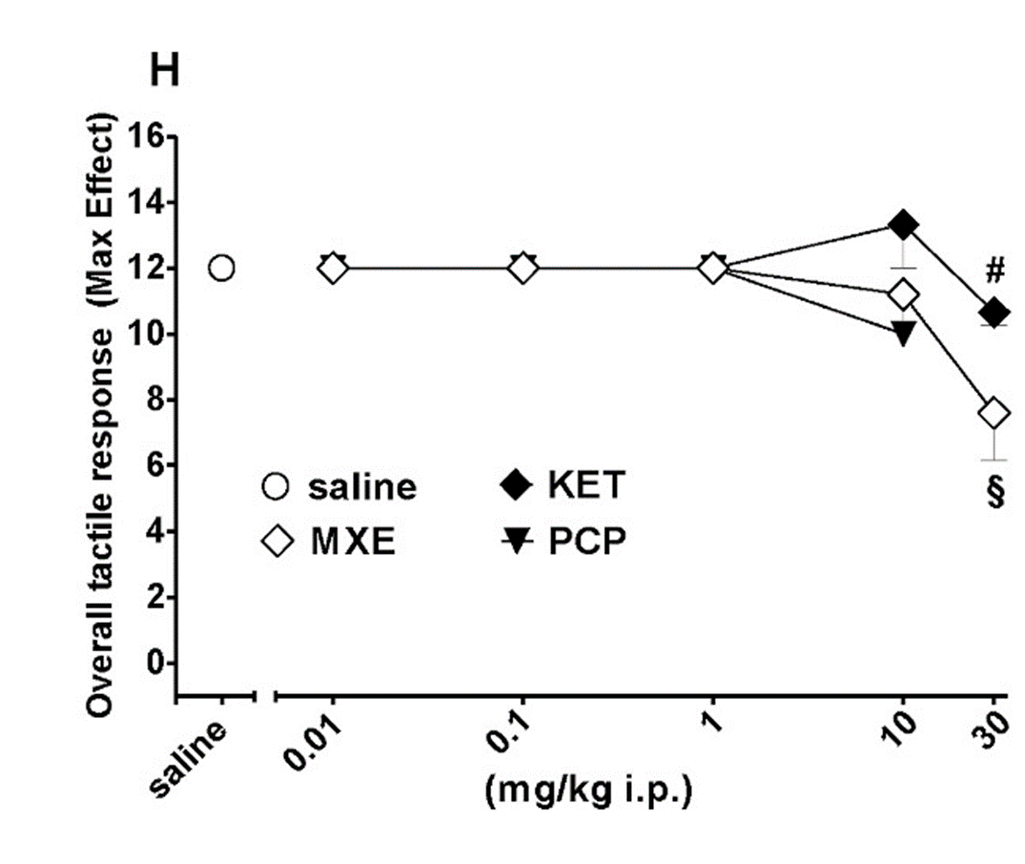
Overall Responses

Slide 21

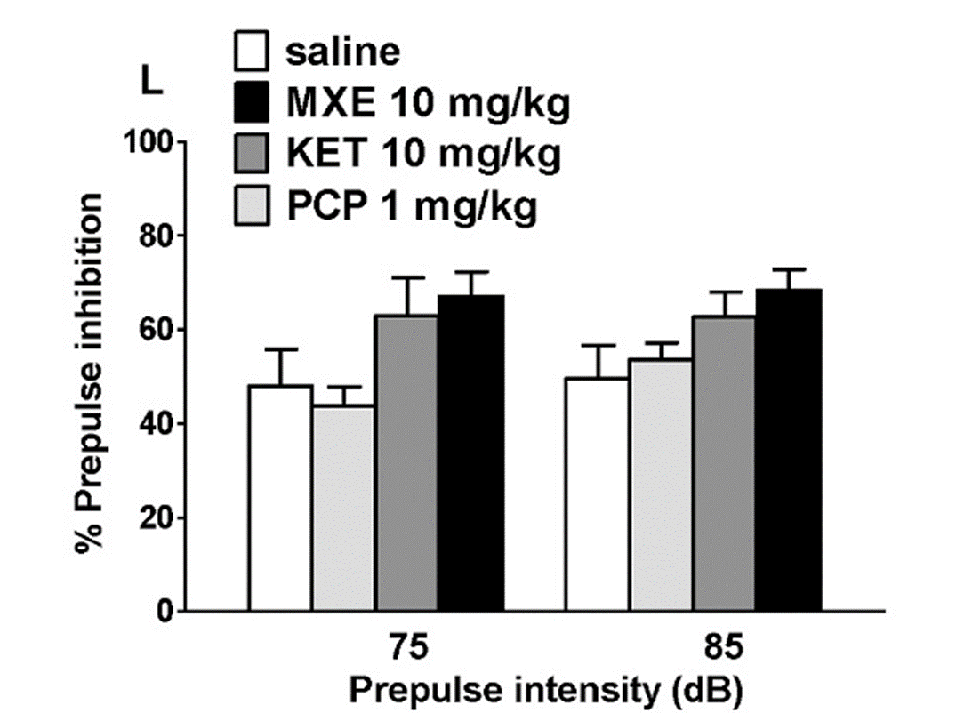
Pre-Pulse Inhibition (PPI)

Slide 22
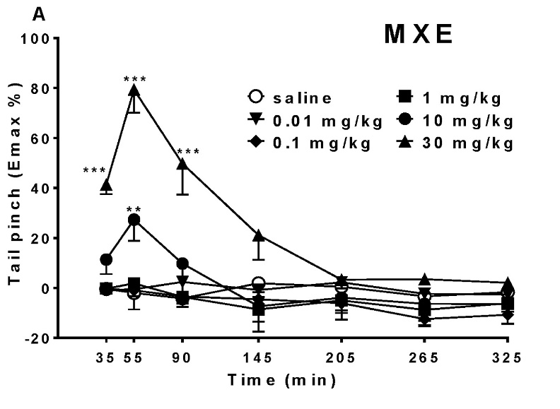
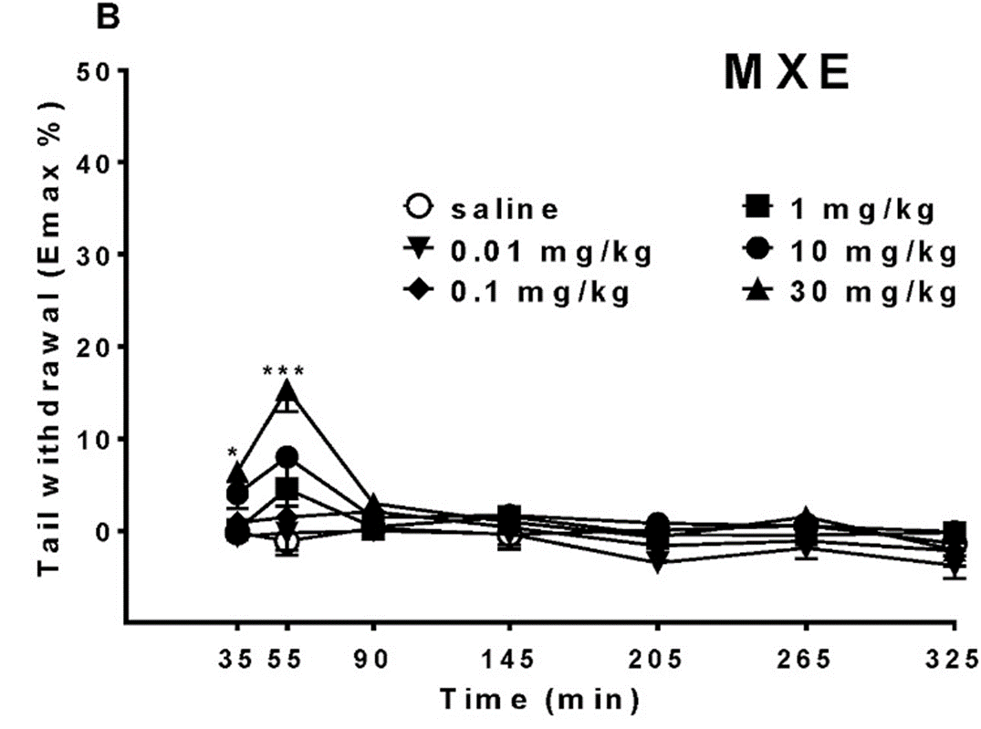
Tail Pinch vs. Withdrawal

Slide 23
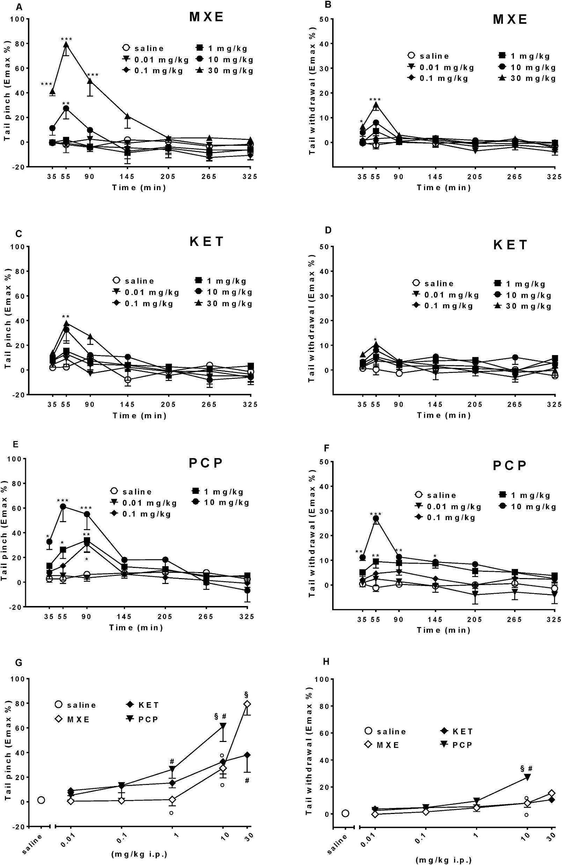
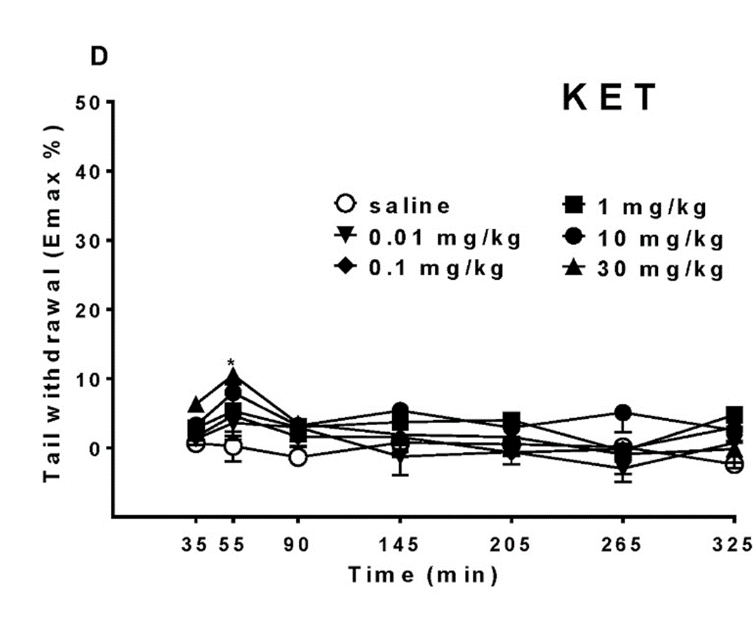
Tail Pinch vs. Withdrawal

Slide 24
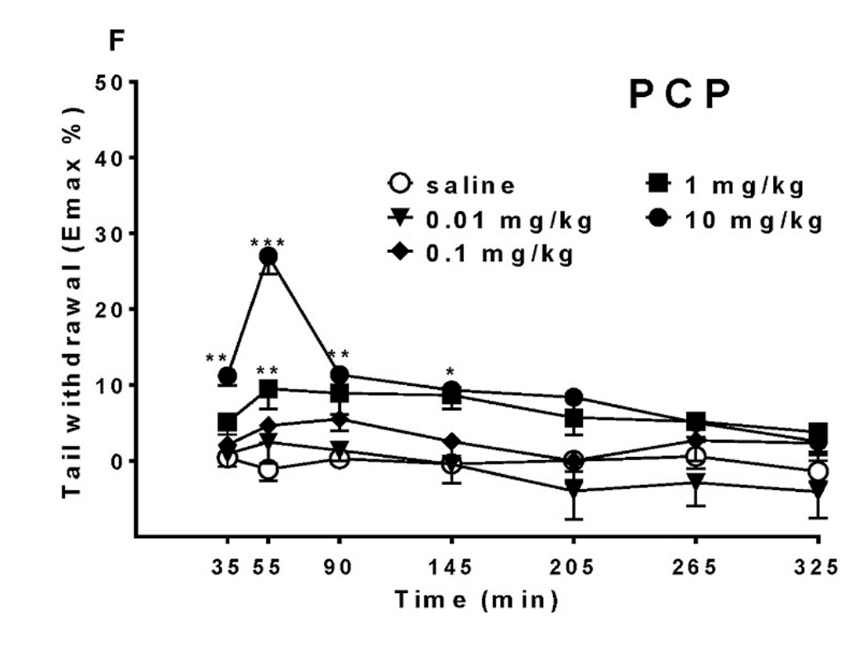
Tail Pinch vs. Withdrawal

Slide 25
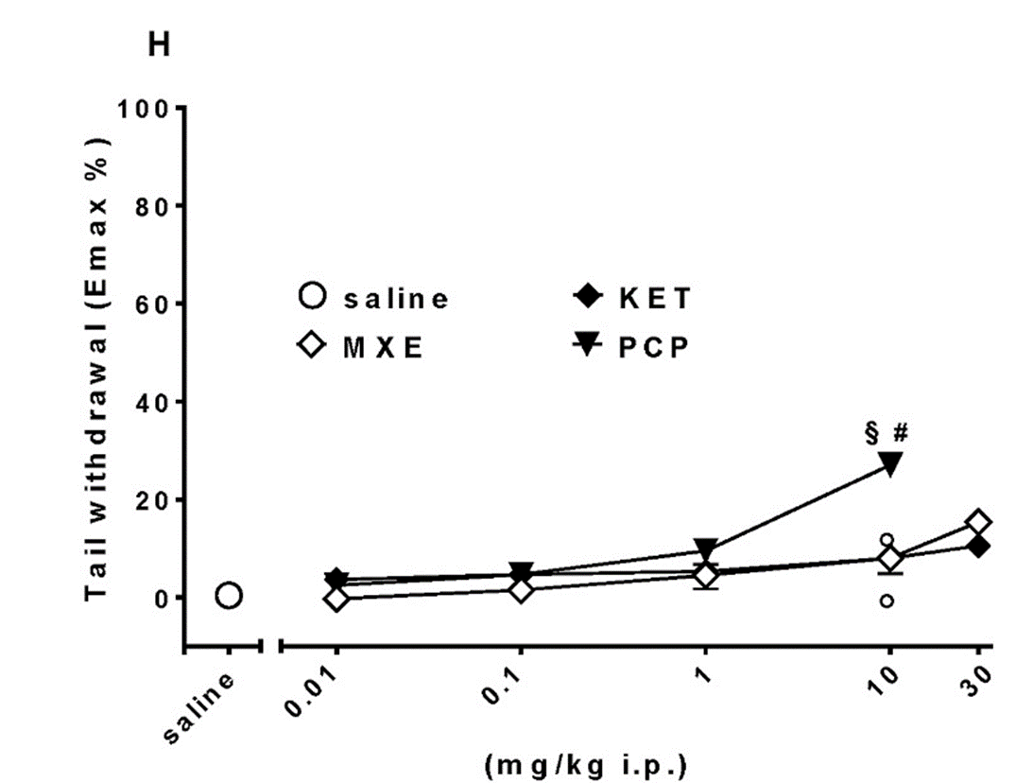
Mechanical vs Thermal

Slide 26
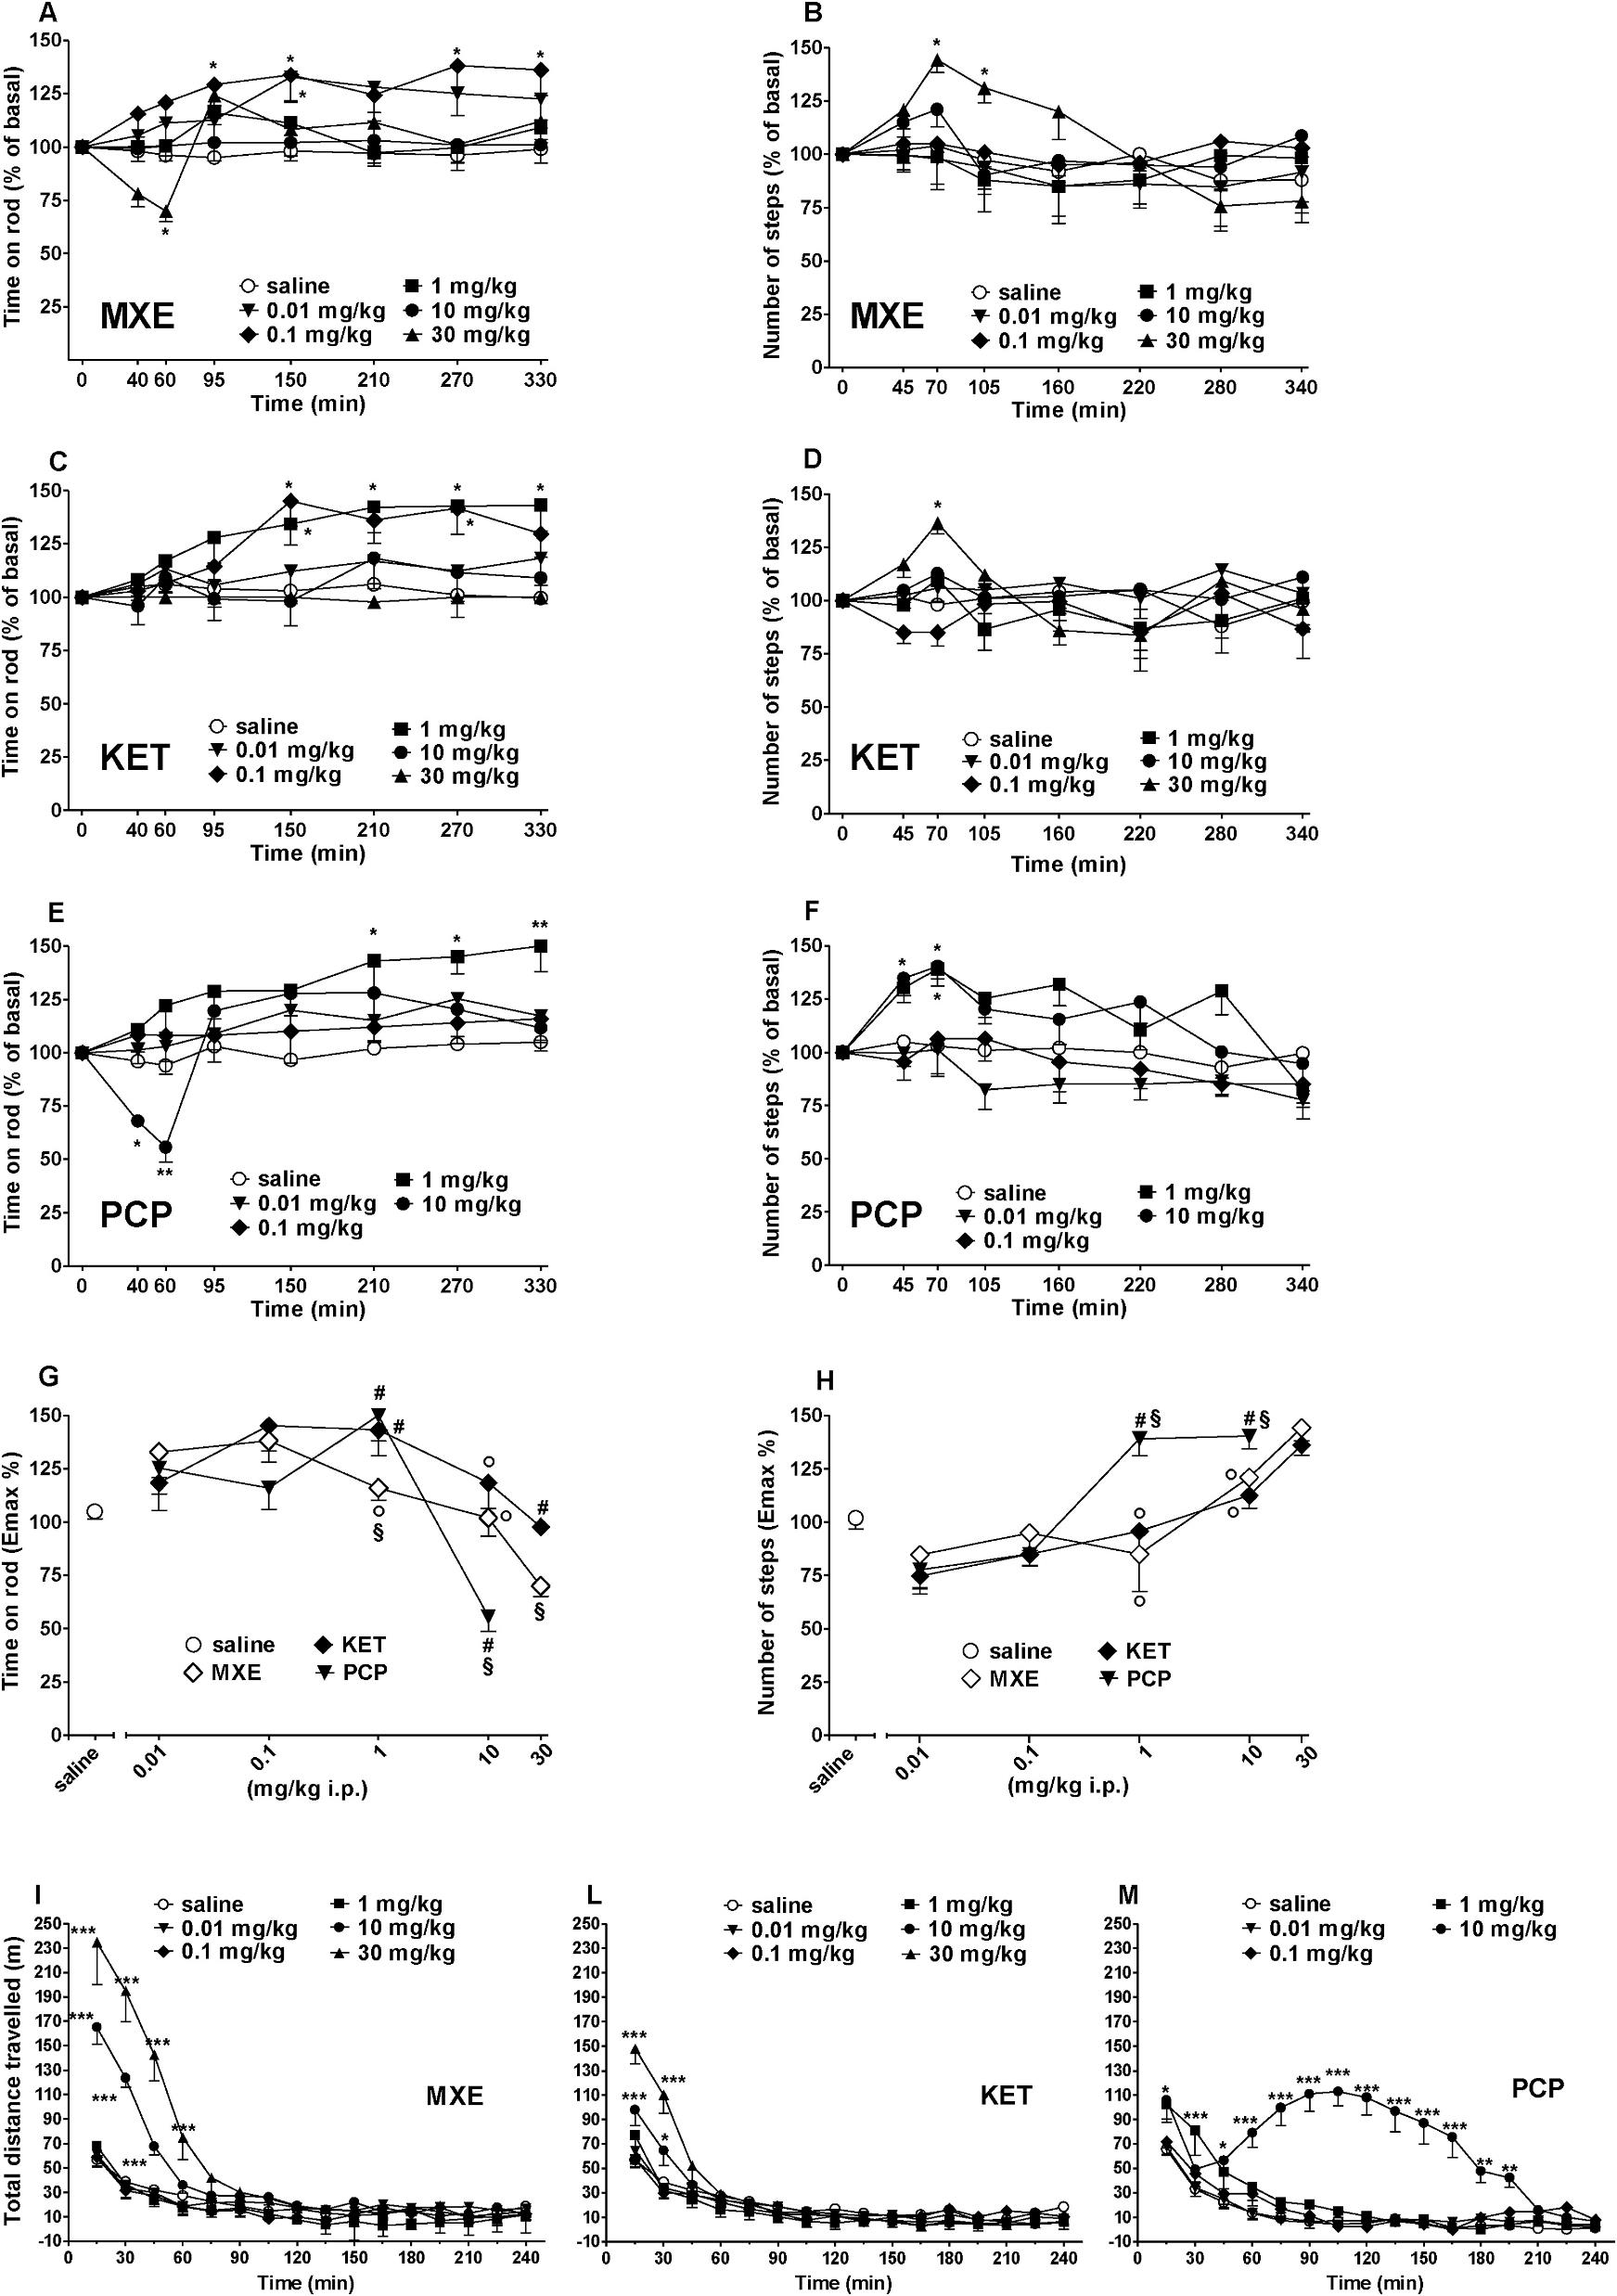
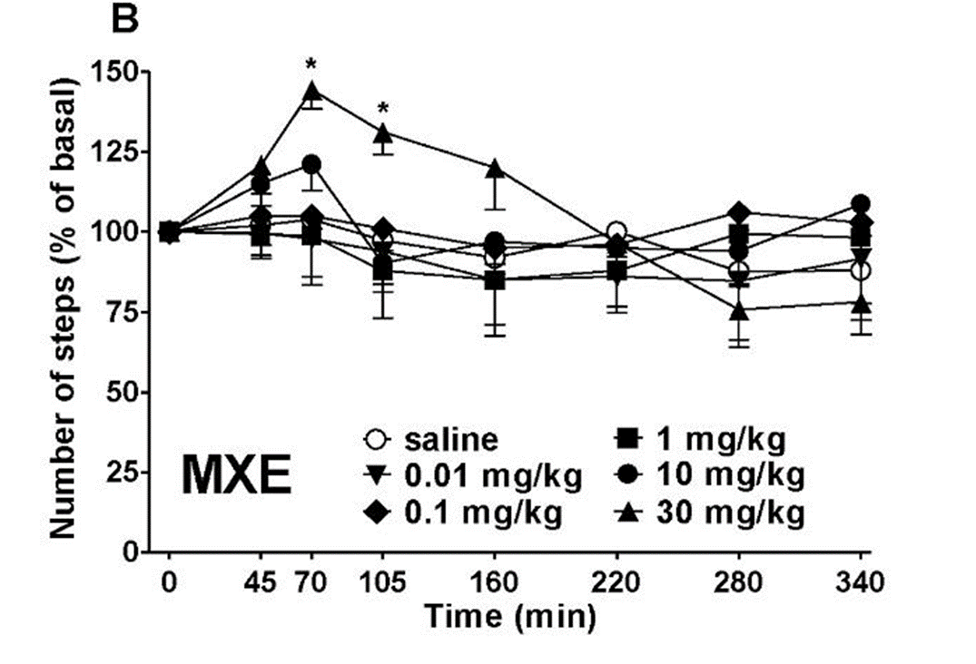
Acelerod vs Drag Test

Slide 27
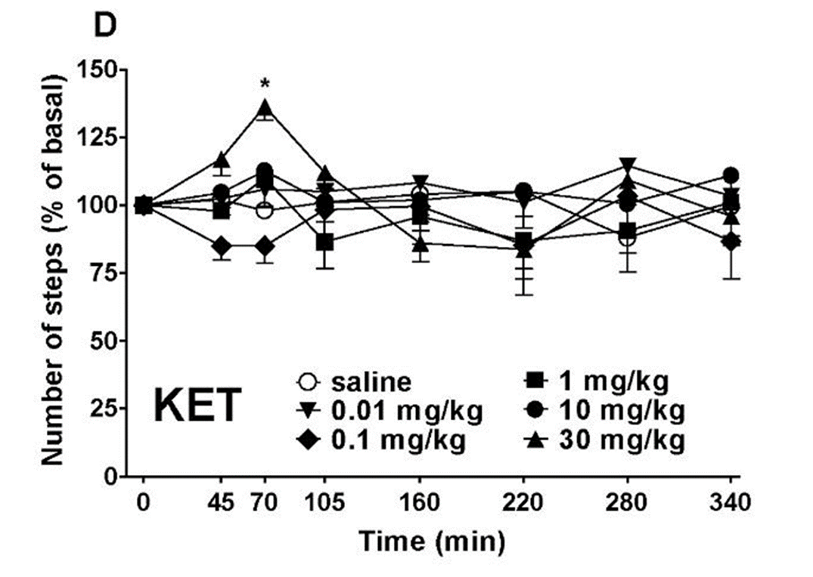
Acelerod vs Drag Test

Slide 28
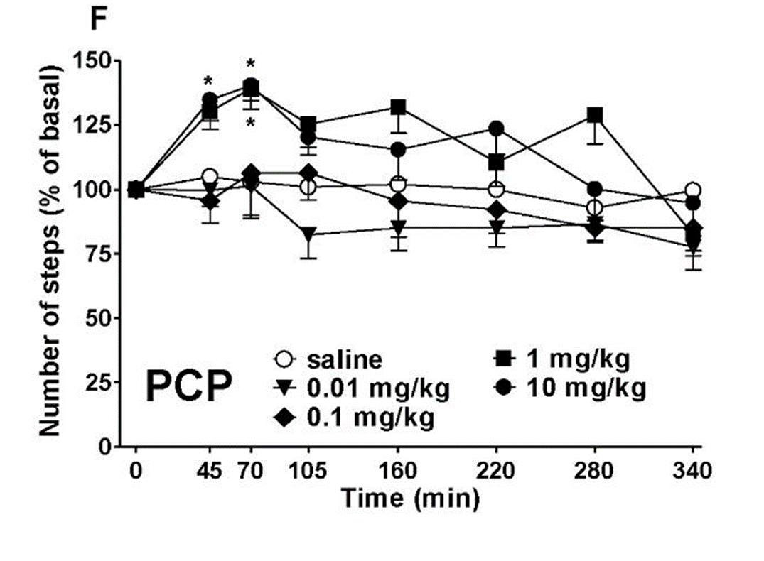
Acelerod vs Drag Test

Slide 29
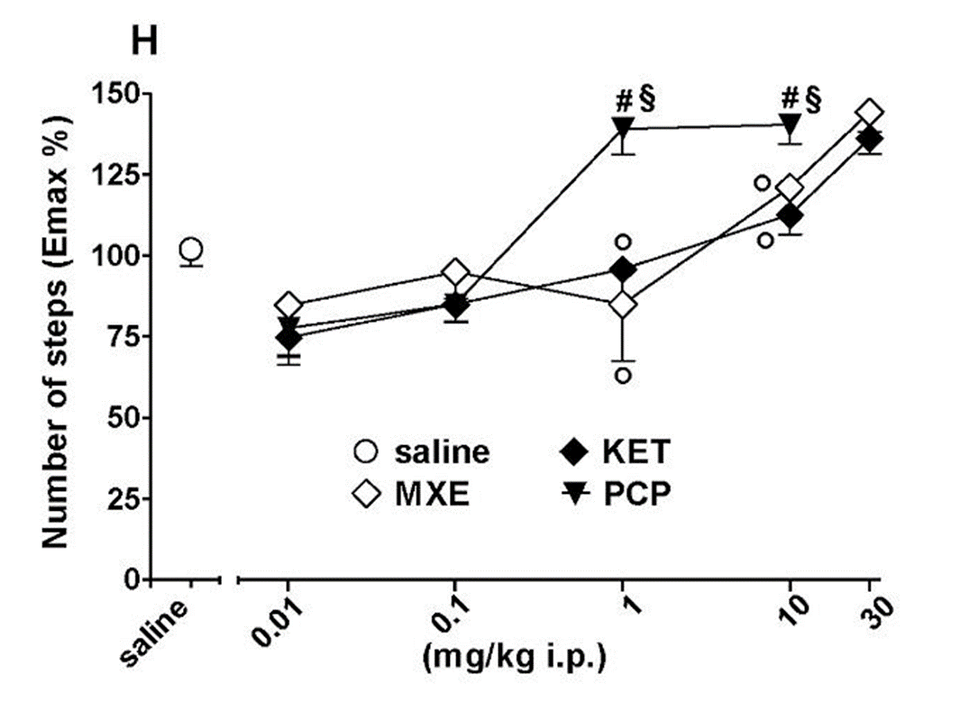
Acelerod vs Drag Test

Slide 30
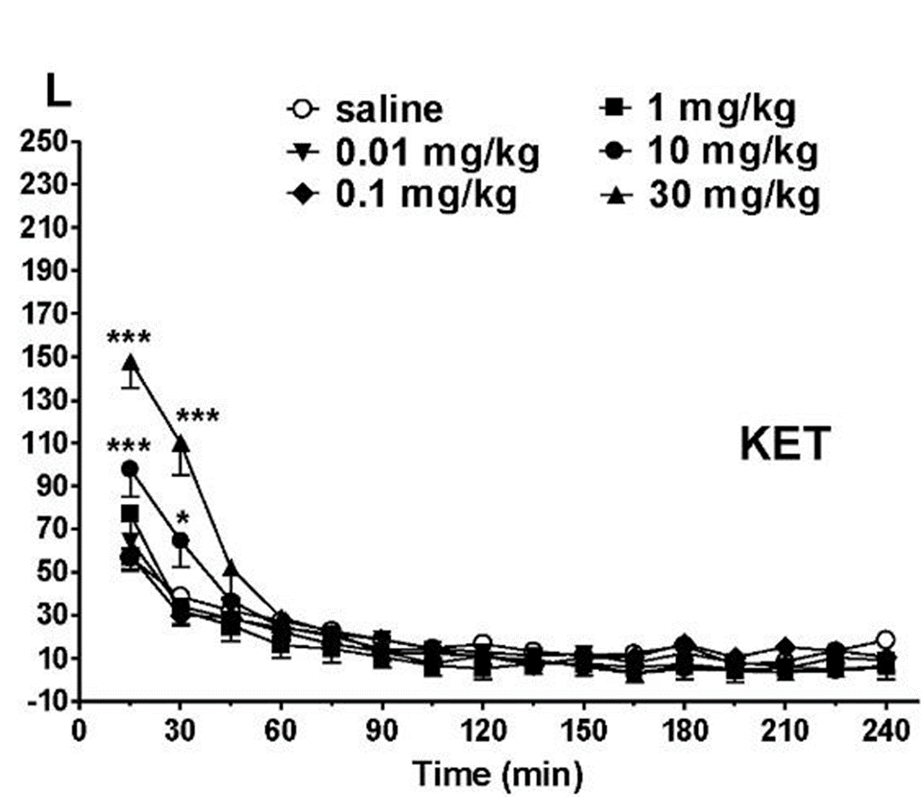
Total Distance Travelled

Slide 31
Total Distance Travelled

Slide 32
Summary
First direct comparison of the in vivo effects of MXE with PCP and KET
Significant changes induced by MXE on sensory function processing
  Similar to intoxicated patients or reported by MXE users
MXE dose-dependently increased the threshold to acute mechanical and thermal pain stimulus
  More effective for mechanical pain than KET
  Similar in thermal pain to KET but less effective than PCP
Able to increase the thermal nociceptive threshold

Slide 33
Zhou et al 2018

Slide 34
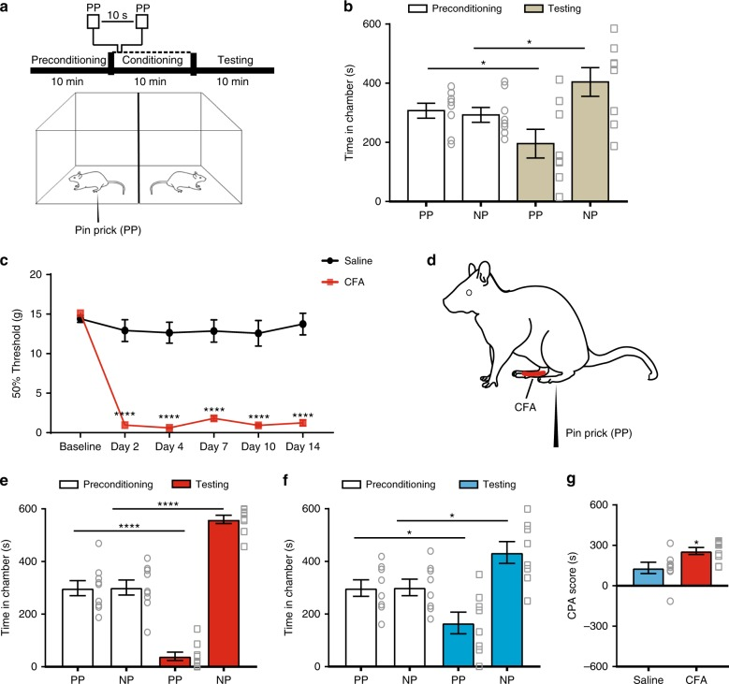
Methods

Slide 35
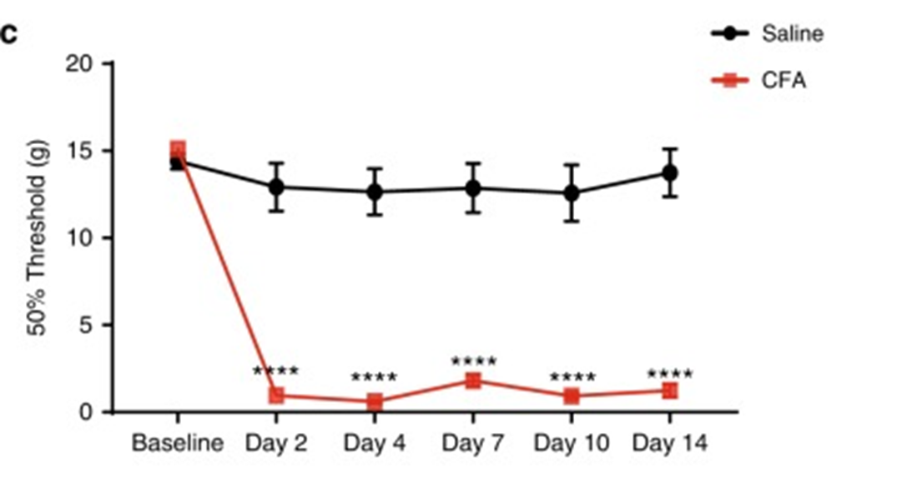
CPA and CFA Injection

Slide 36
CFA Rats

Slide 37
Saline Injections and Aversive Response

Slide 38
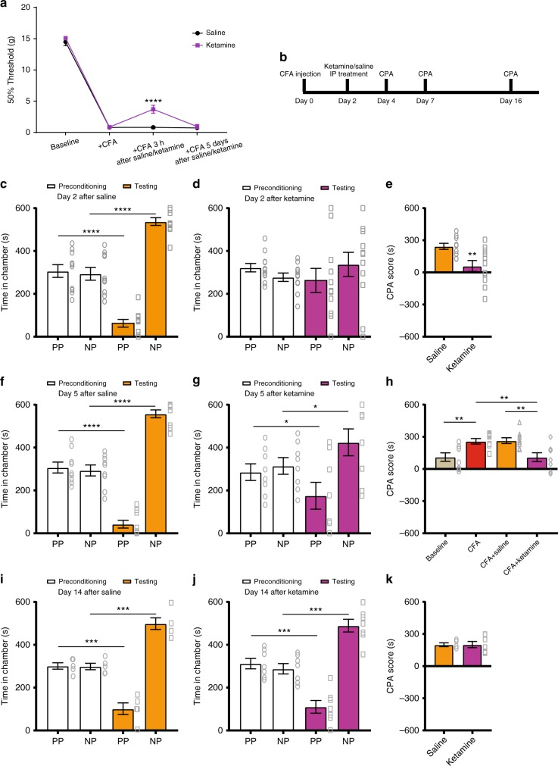
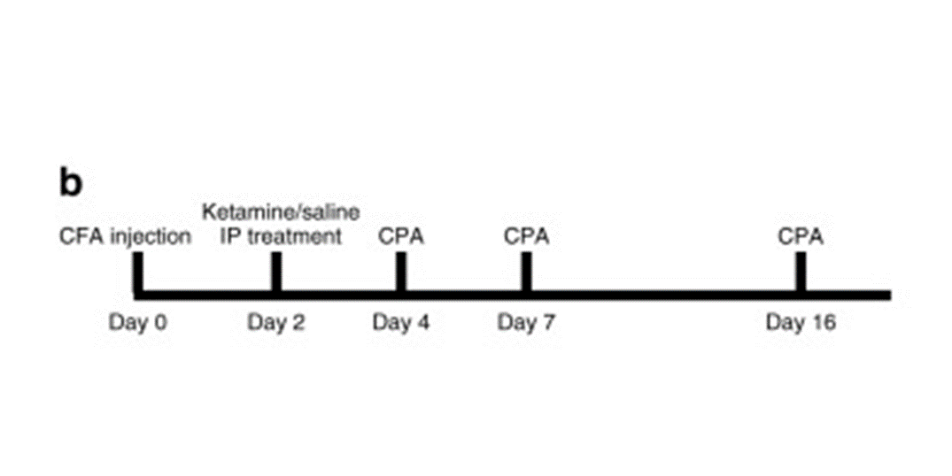
Ketamine and CPA Test

Slide 39
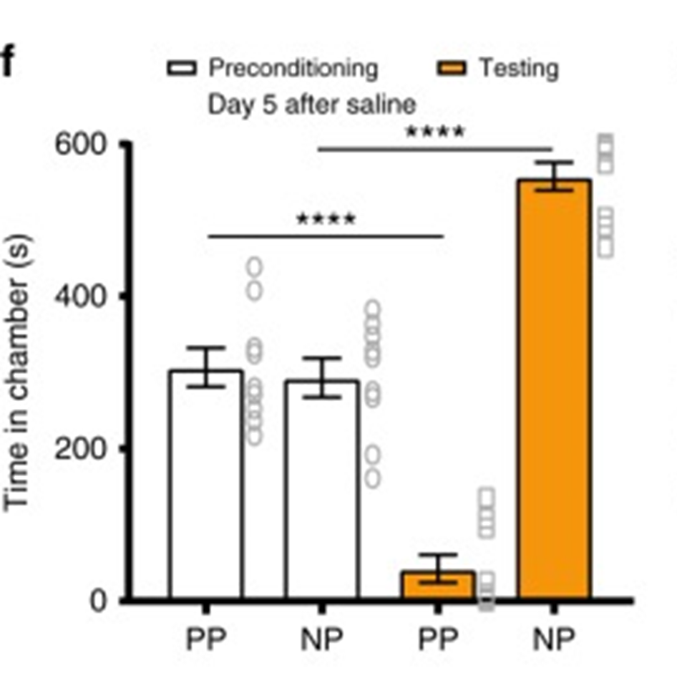
CPA - Saline

Slide 40
CPA - Saline

Slide 41
CPA - Ketamine

Slide 42
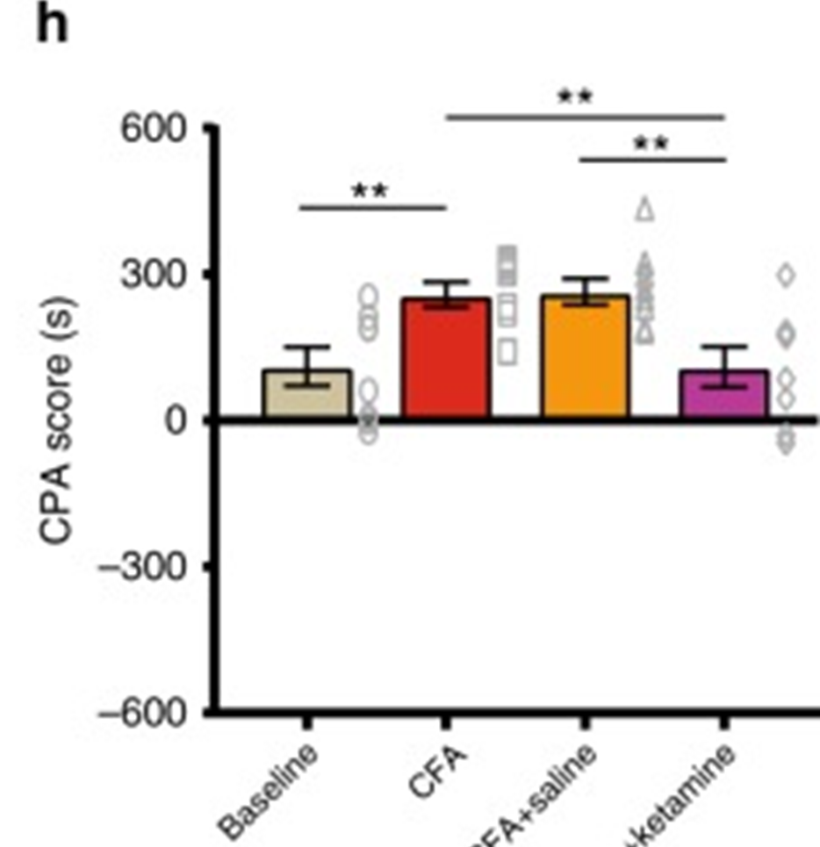
CPA - Ketamine

Slide 43
CPA - Ketamine

Slide 44
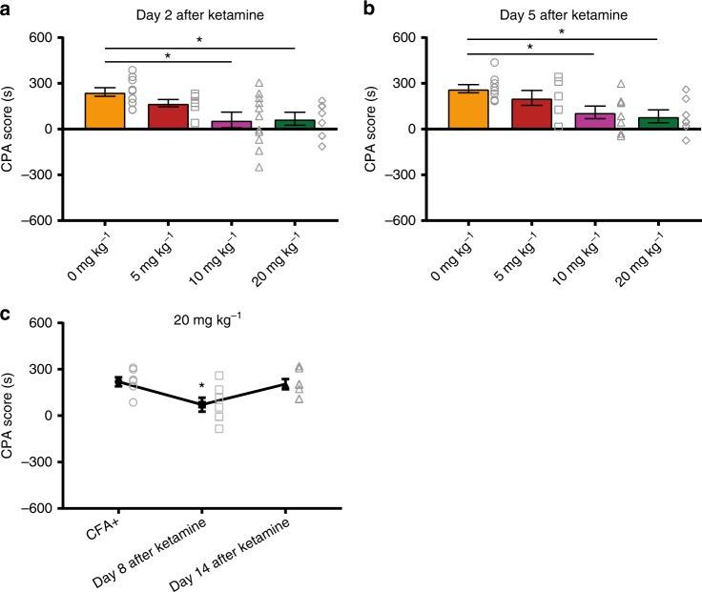
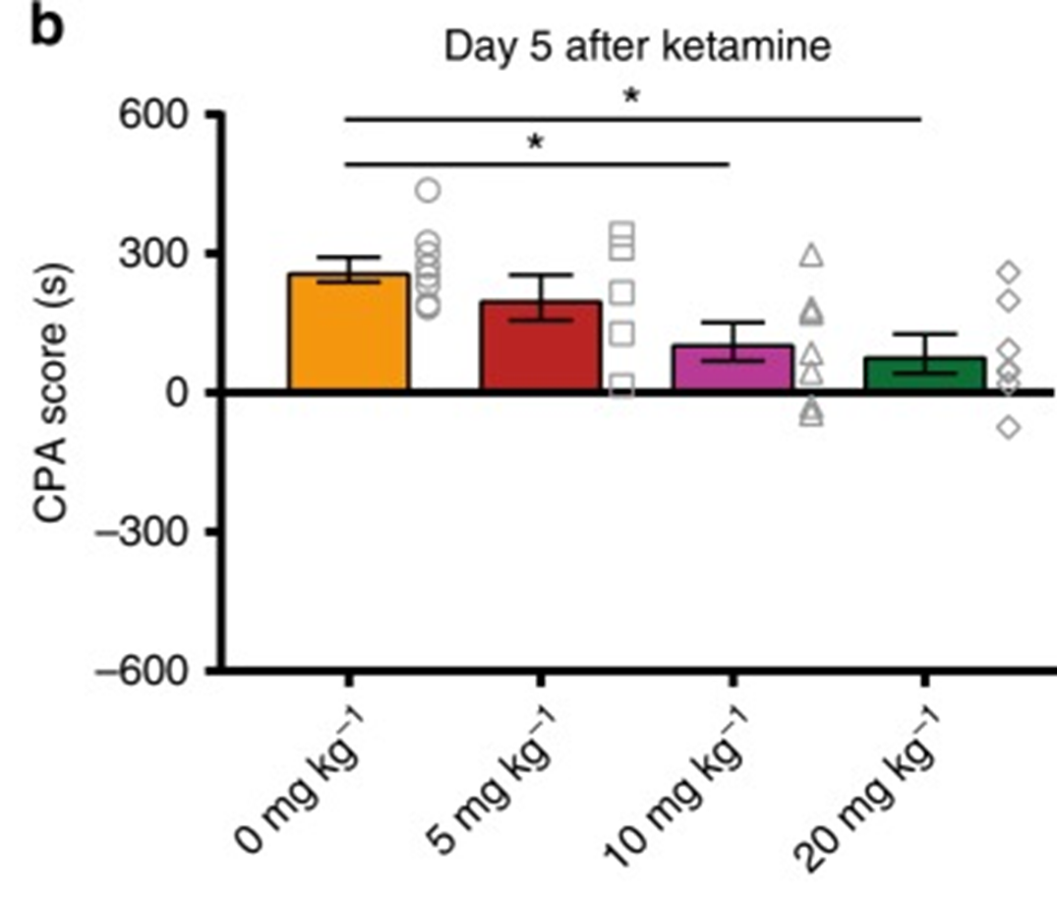
Dose-Response

Slide 45
CPA Response

Slide 46
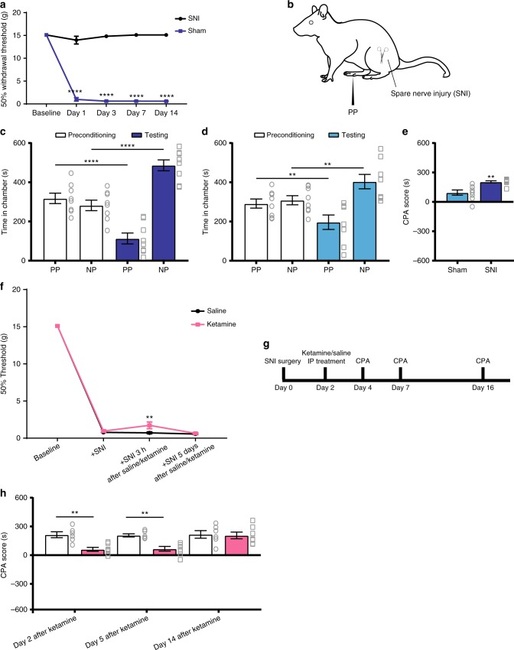
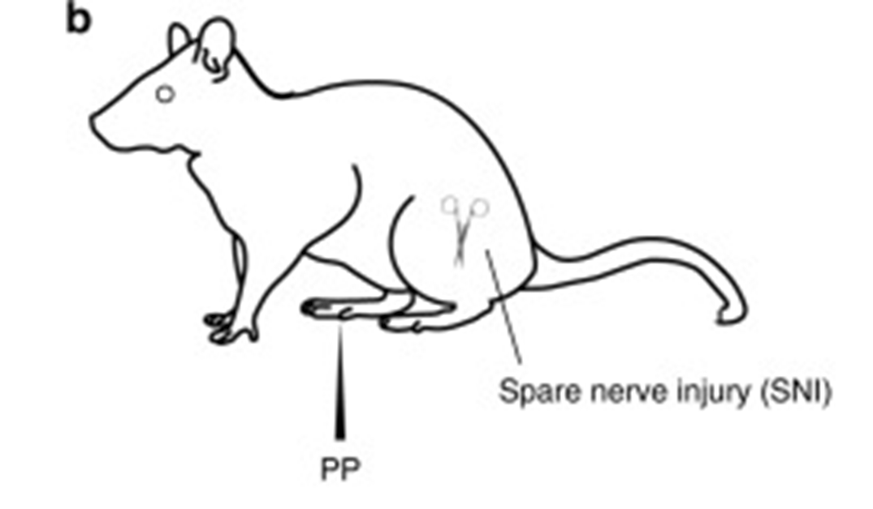
Neuropathic Pain Model

Slide 47
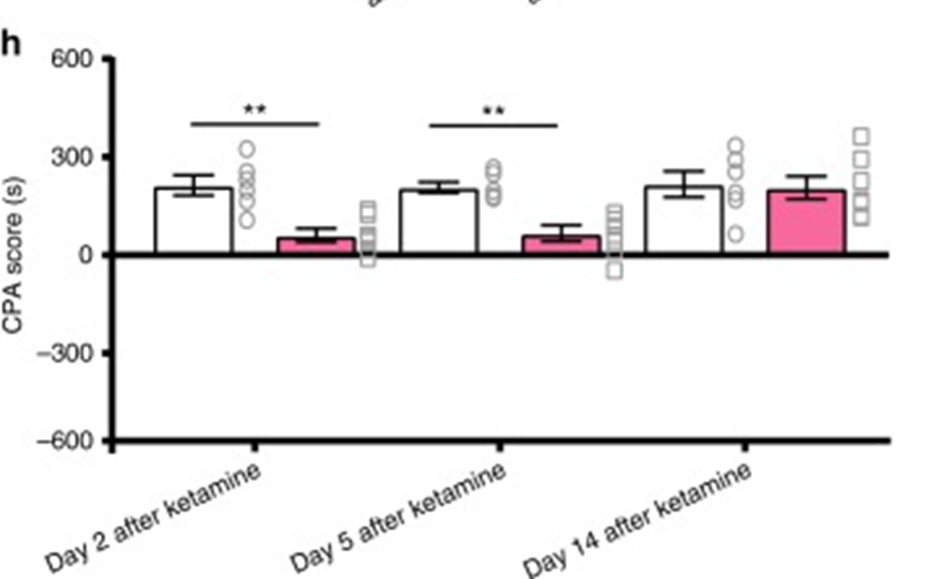
CPA

Slide 48
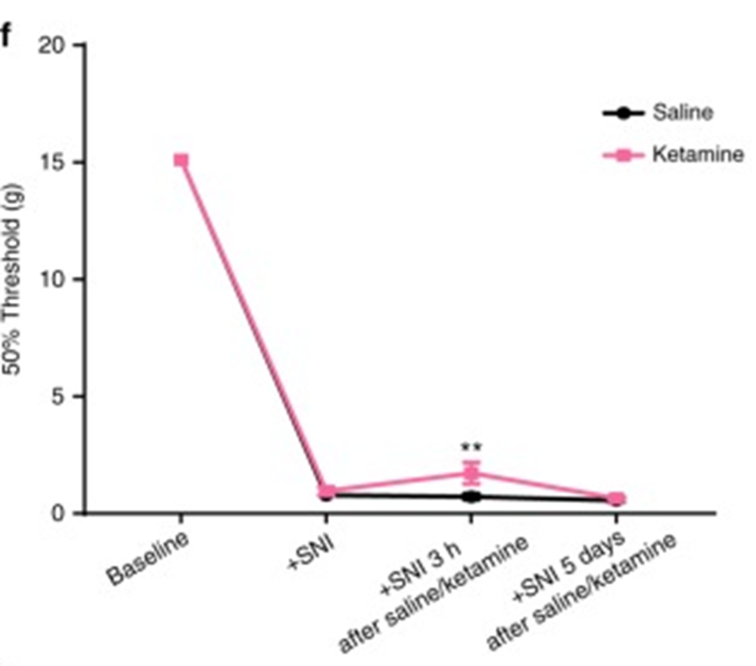
PP and Ketamine

Slide 49
CPA and PP

Slide 50
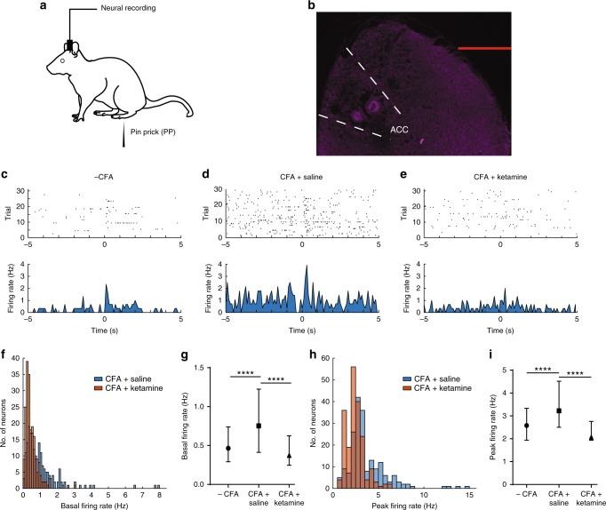
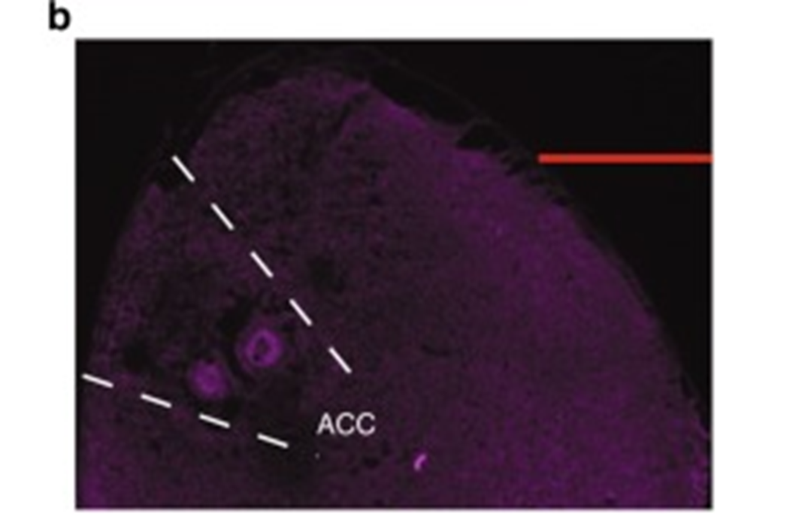
ACC

Slide 51
ACC Neurons

Slide 52
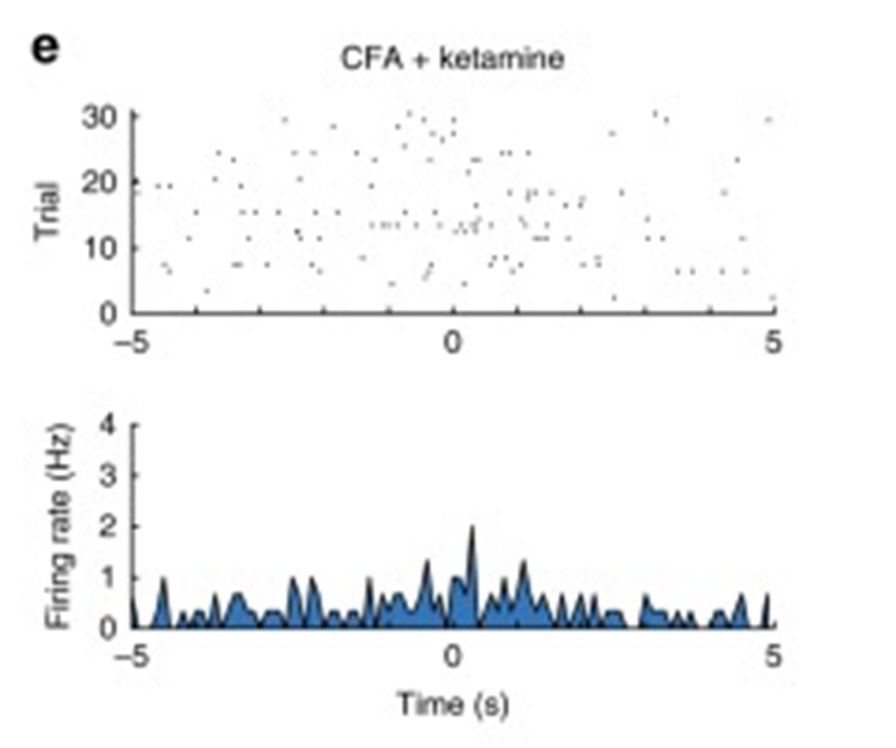
CFA + Saline or Ketamine

Slide 53
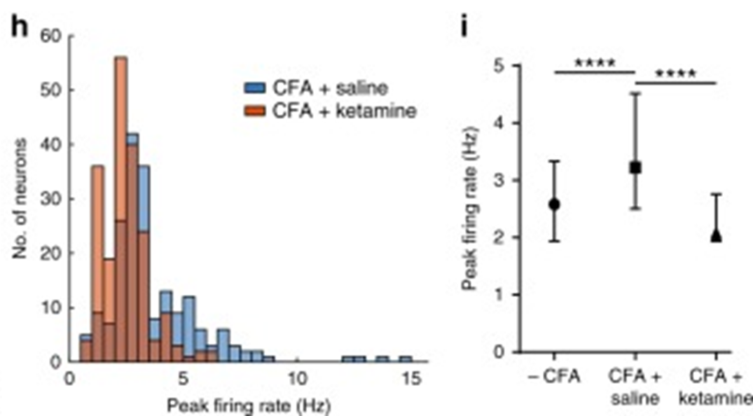
Basal Firing Rates

Slide 54
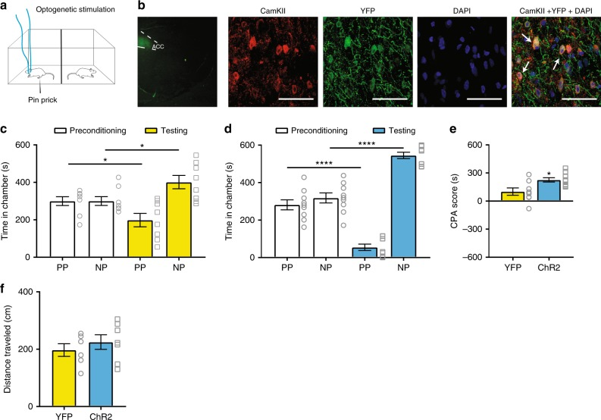
ACC Optogenetics

Slide 55
YFP-ChR2 Expression

Slide 56
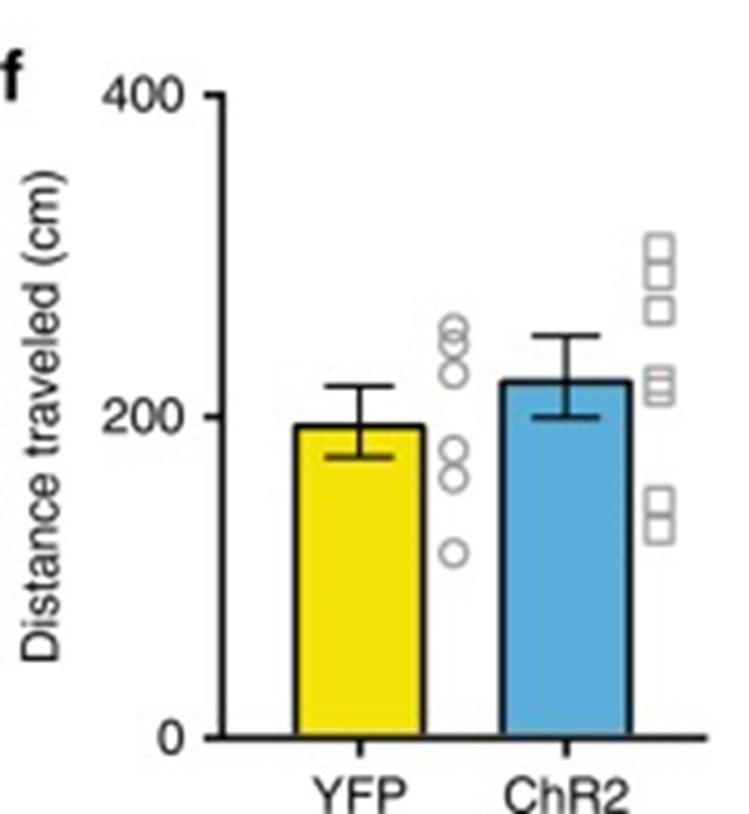
PP

Slide 57
PP and CPA

Slide 58
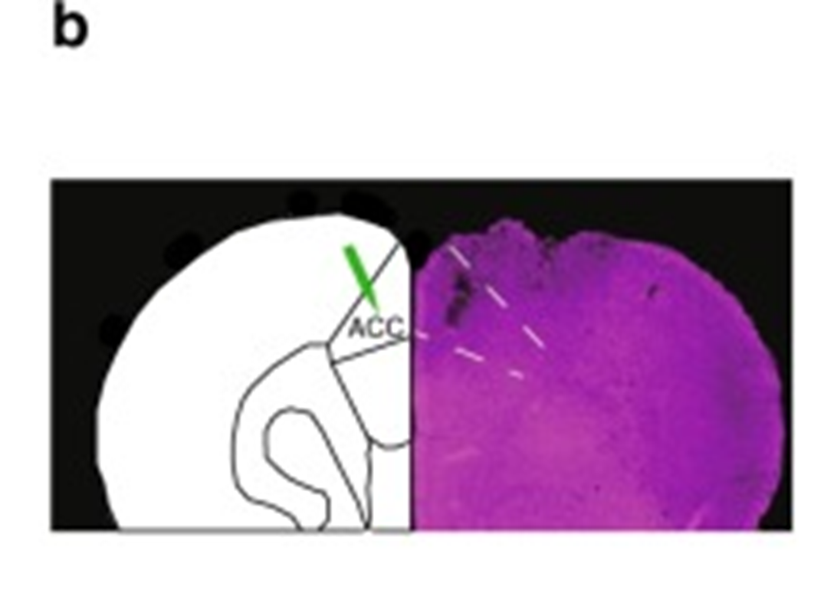
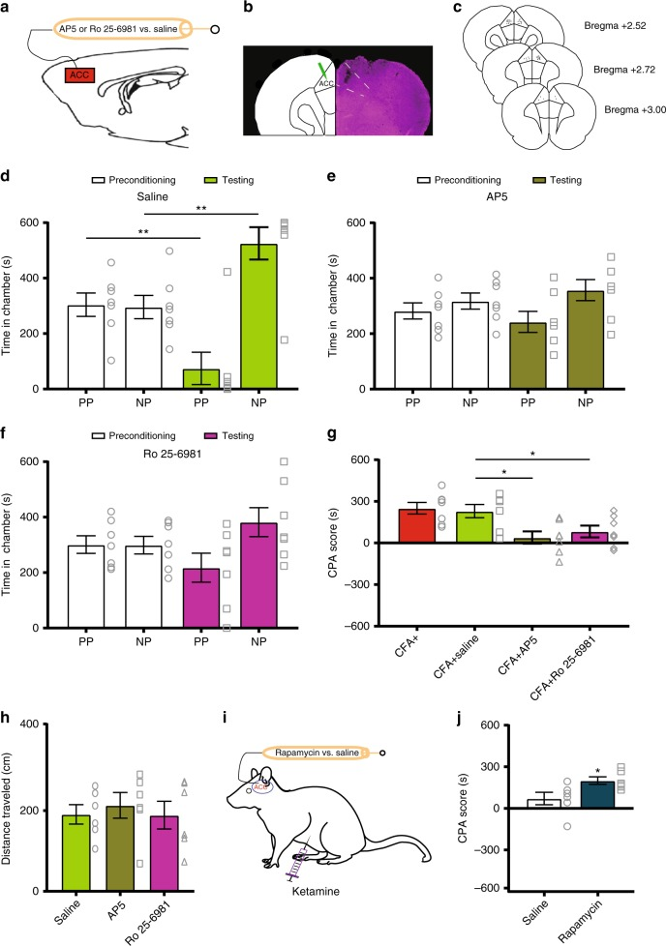
Intra-ACC Drug Infusions

Slide 59
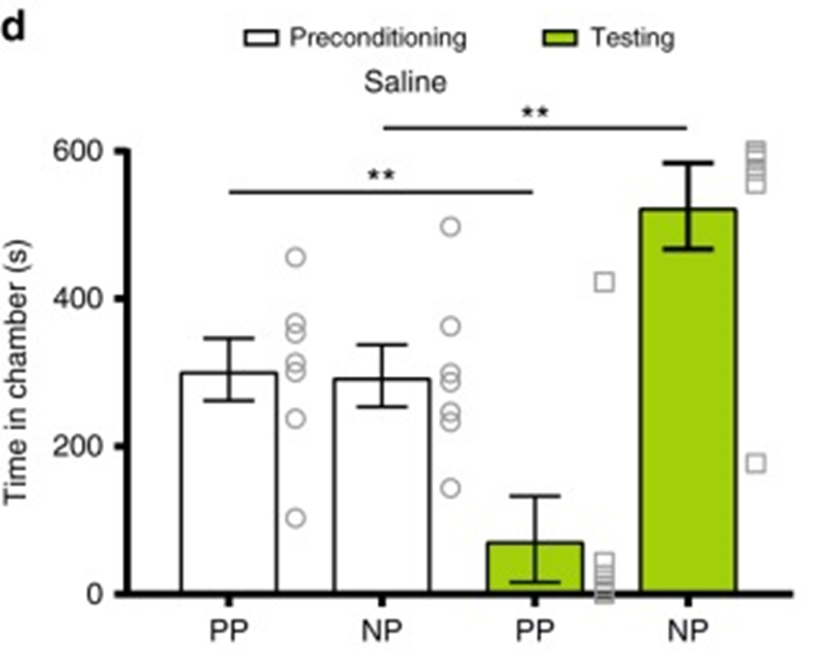
Injections and PP

Slide 60
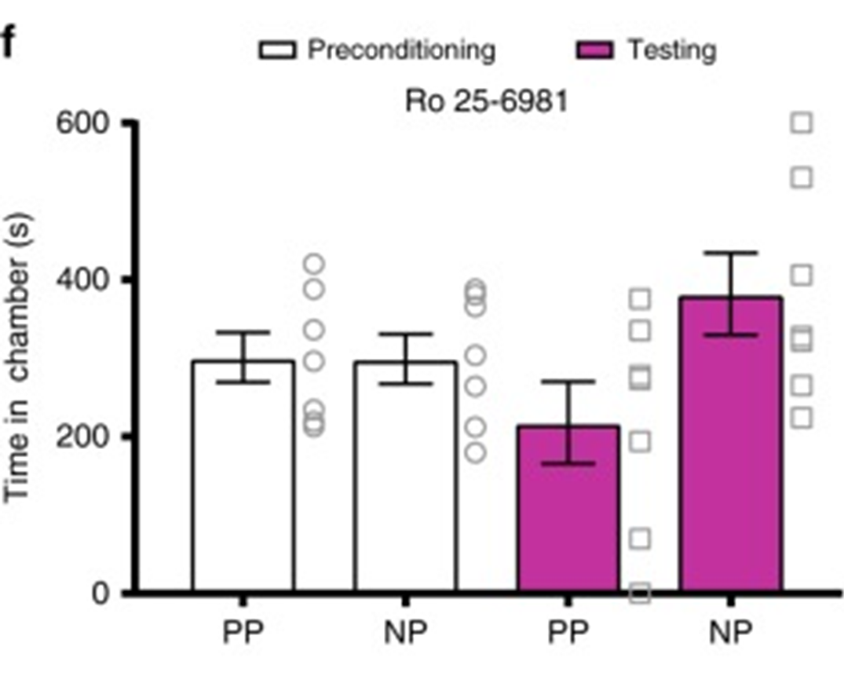
PP

Slide 61
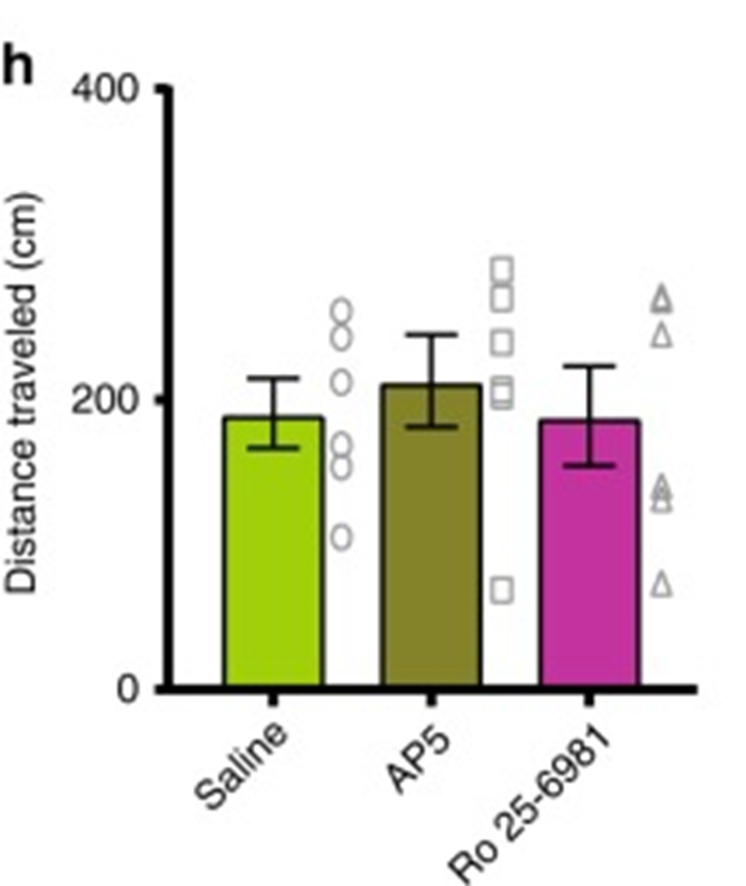
CPA and Distance Travelled

Slide 62

Rapamycin CPA

Slide 63
Summary
Reduce hyperactivity of the neurons in the anterior singulate cortex (ACC)
Single dose of Ketamine inhibits the affective symptoms of chronic pain over a prolonged period of time
Abnormal affective expression of chronic pain as a novel therapeutic approach
Chronic pain can increase aversive respond to mechanical pain elsewhere

Slide 64


